Slide 1
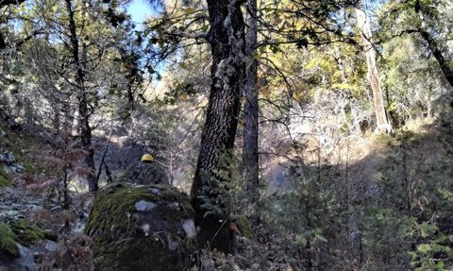
Team 20
Forest Management Planning on Private Non-Industrial Forestland

Slide 2
Table of Contents
History of Taylor Property and Maps
4 steps to creating a Forest Management Plan
Introducing Dr. Taylor’s Dilemma
Data Collection and Assessing Conditions
Identifying Threats
Evaluating Treatment Options and Barriers
CFIP and Finances
Conclusion

Slide 3
History of the Taylor Property
154 acres purchased in 1999, nonindustrial property
Near Grizzly Flats and Leoni Meadows, 3200 ft elevation
Was not burned in the Caldor fire
Mainly hardwood and ponderosa pine
Mining done in 1800s damaging the landscapes
Logged 4 times (early and mid 1900s, 1998, and 2008)
--> first 3 were done badly and damaged the forest’s health

Slide 4
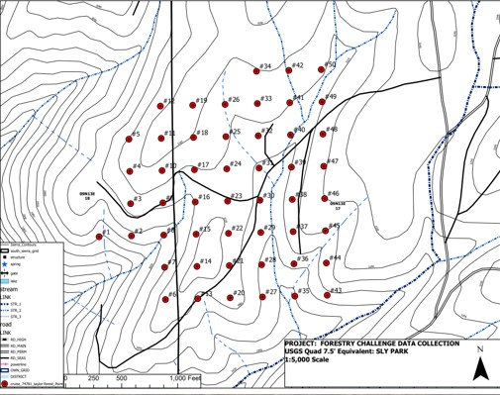
Pictures and maps of the property

Slide 5
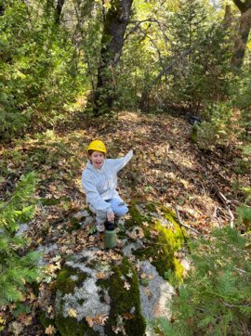
4 steps to creating a Forest Management Plan
Define objectives
2. Assess conditions
3. Identify threats
4. Evaluate treatment options
Let's take a look....

Slide 6
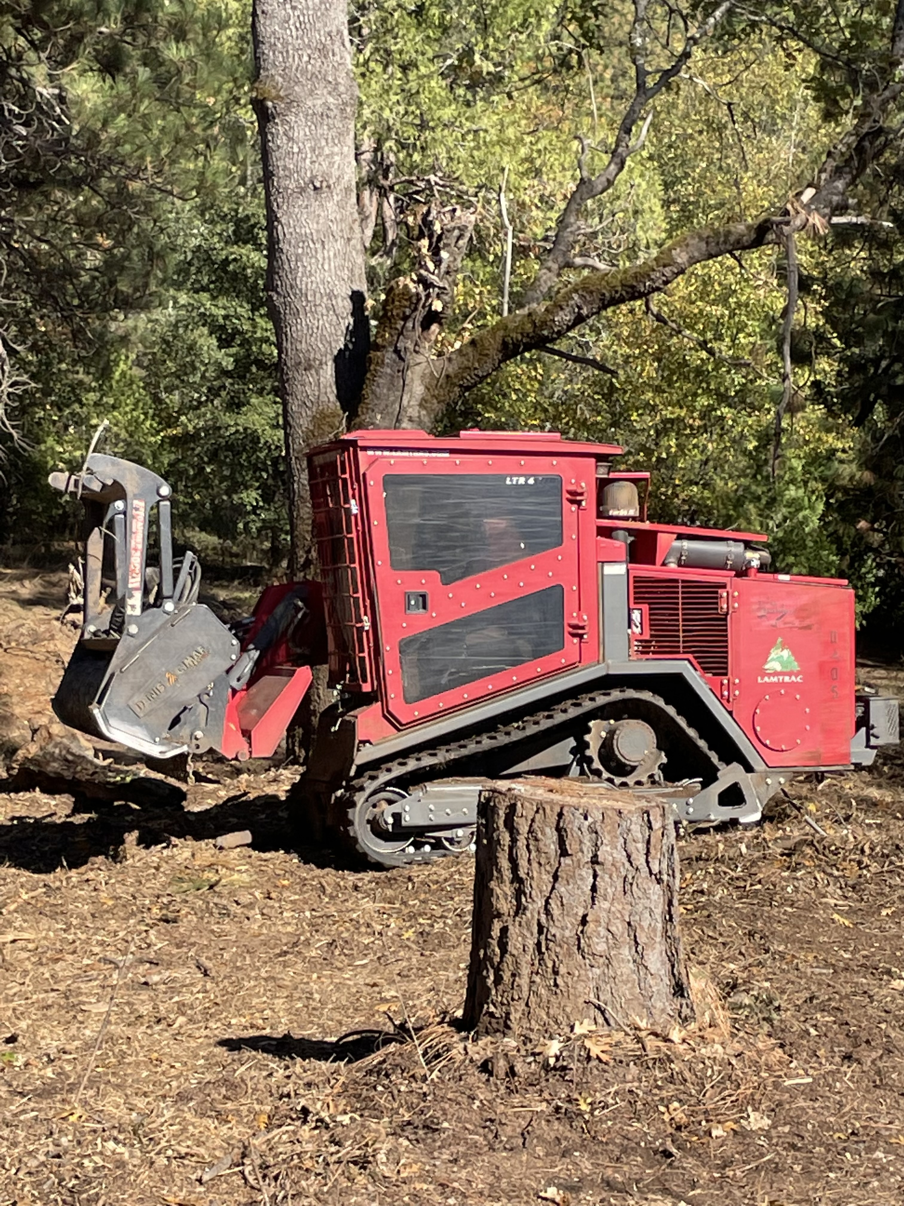
Introducing Dr. Taylor's Dilemma
Main Goals
Fire safety
Forest health
Economic return
Accessory Goal
Community Value

Slide 7
4 steps to creating a Forest Management Plan
Define objectives
2. Assess conditions
3. Identify threats
4. Evaluate treatment options
Let's take a look....

Slide 8
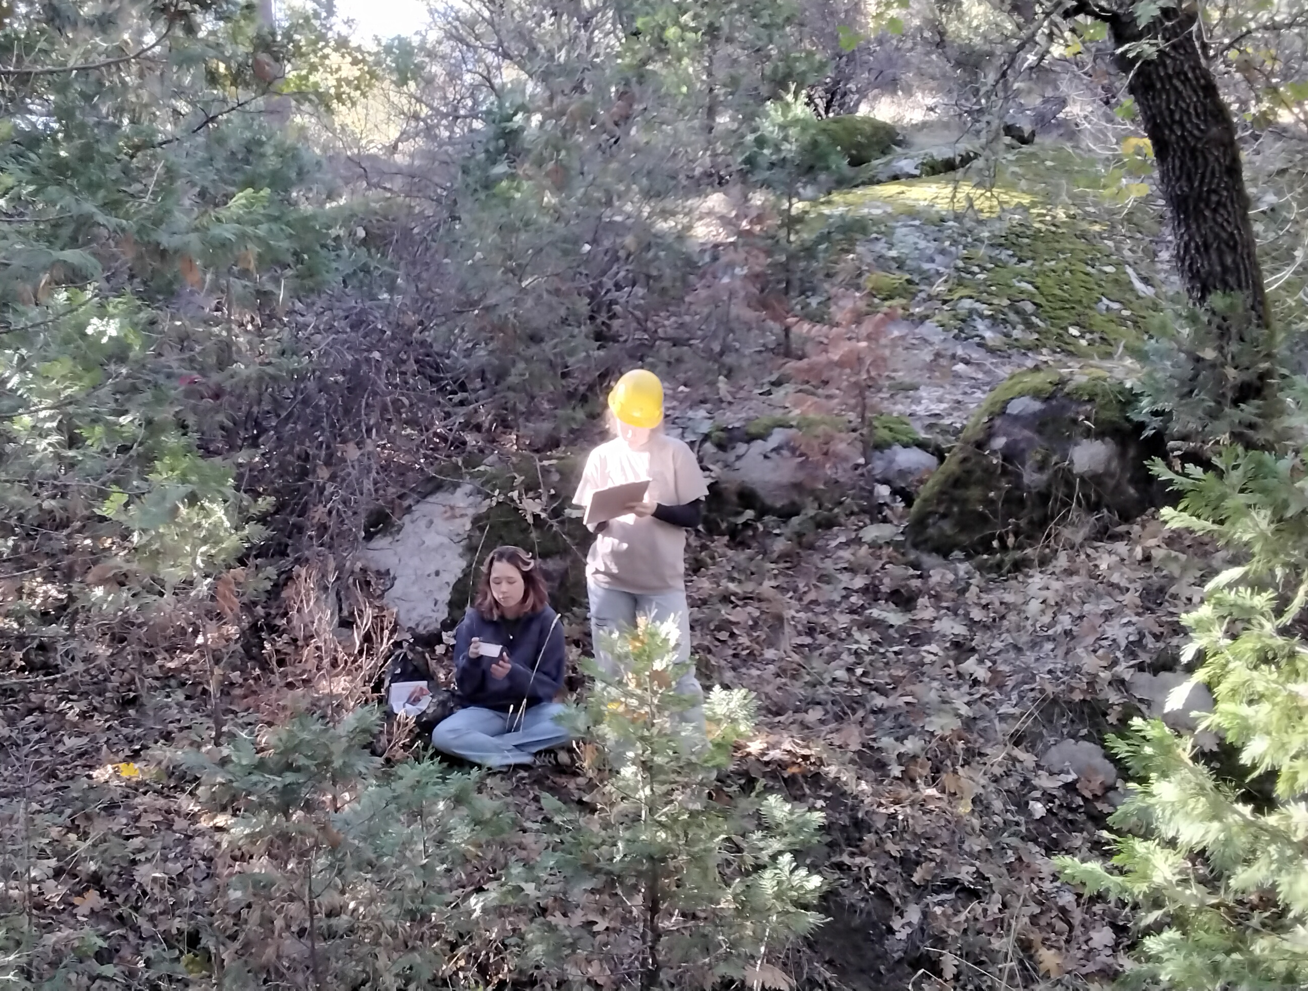
Data Collection: Methods
1/10-acre plot, circular with 37.2 ft radius
DBH, species composition, number of trees, basal area, growth rate
Tools used: Logger’s Tape, 100’ Tape measure, Angle Gauge, Compass, Tree Bore

Slide 9
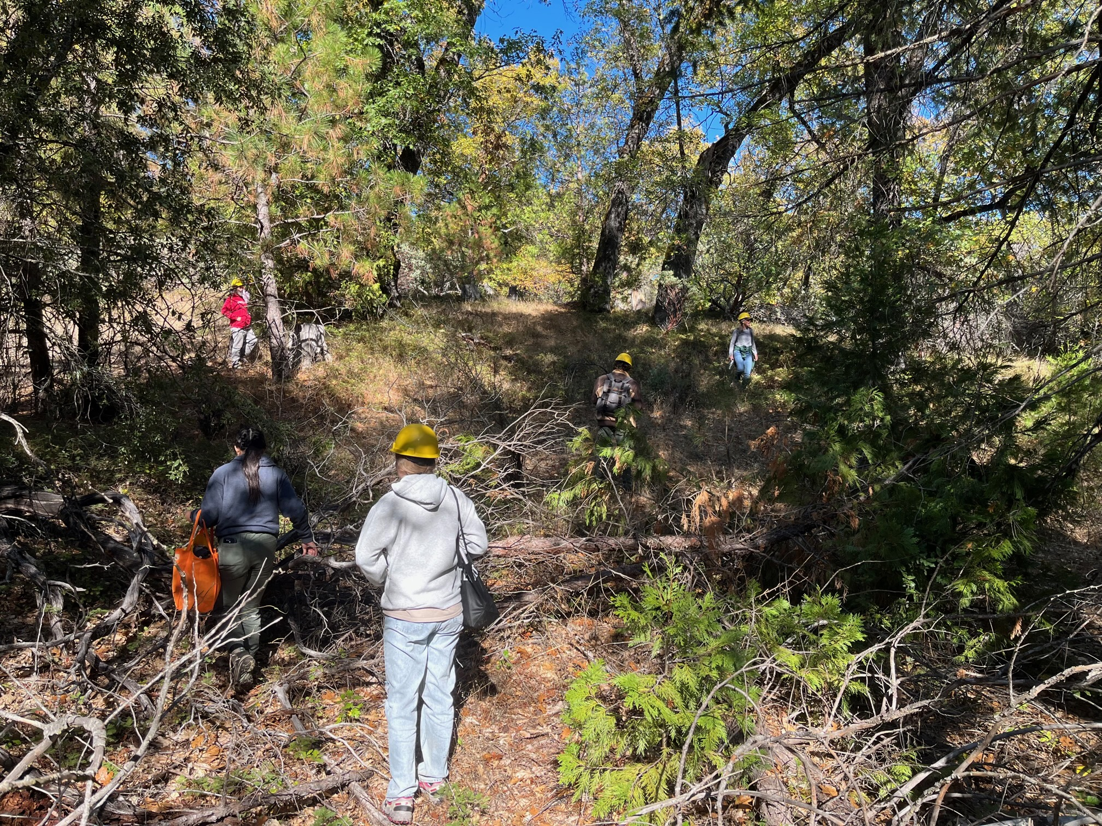
This is where we collected data:

Slide 10
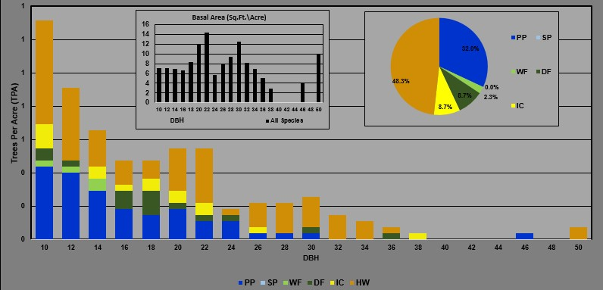
Stand Data

Slide 11
154 Acres Visualized
Green – Total Land Area
Purple – Insect Affected
Yellow – Drought Affected
Black – Disease Affected
Red – Ladder Fuel Issues

Slide 12
4 steps to creating a Forest Management Plan
Define objectives
blah
TO DO:
2. Assess conditions
3. Identify threats
4. Evaluate treatment options
Let's take a look....

Slide 13
Threats
# of Snags (avg.) |  |  | Growth Rings (avg.)
Less than 10” | 10”-20” | Over 20” | Width last 10 | Width 10”-20”
19 | 2 | 1 | 1.37 | 1.80
Evidence of Pathogens and Drought
Indicates slow Growth (see core sample)
Ladder Fuels (Total) |  |  |  | Threats
None | Low | Med | High | Insects | Droughts | Pathogens
3 | 4 | 8 | 11 | 9 | 12 | 14
High-Fire Risk

Slide 14
4 steps to creating a Forest Management Plan
Define objectives
blah
TO DO:
2. Assess conditions
3. Identify threats
4. Evaluate treatment options
Let's take a look....

Slide 15
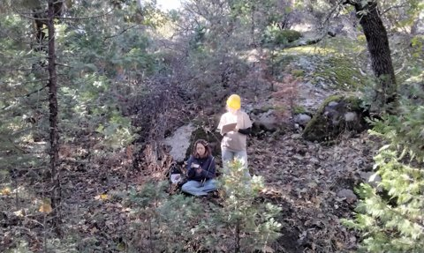
Evaluate Treatment Options
Goals: Low-Cost, Time-Efficient, Sustainability
Receive as much aid as possible from CFIP
Follow Dr. Taylor’s Objectives

Slide 16
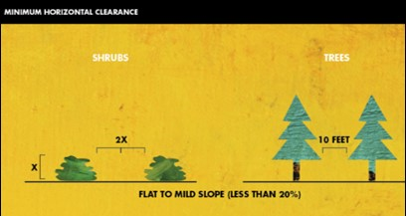
Fire Safety
Step 1: Buffer around property (David Thompson)
Step 2: Hire Mastication Team
(Justin Parker and Philip Huffman)
Step 3: Herbicide Treatment
(Mark Stewart)
Step 4: Upkeep
(Justin Parker and Philip Huffman)

Slide 17
Drought
Step 1: Remove Shrubs via Mastication (David Thompson)
Step 2: Is a tree worth the resources it's using? Cut with Chainsaw any unnecessary trees (unhealthy or small oaks) (Tim Treichelt)
Step 3: Plant Conifers (drought tolerant and cost positive in the future)
(Justin Parker and Philip Huffman)

Slide 18
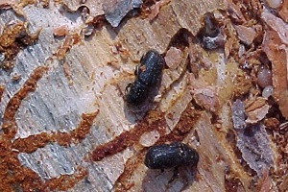
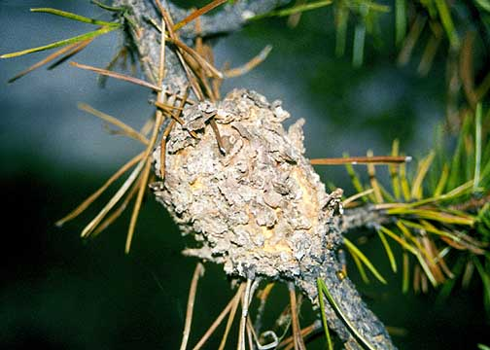
Bark Beetles and Pathogens
- Step 1: Remove affected trees via mastication (Justin Parker)
- Step 2: Reduce competitions
(Tim Treichelt)
- Step 3: Prioritize nutrients to conifers (Tim Treichelt)
- Step 4: Increase pitch
(Justin Parker and Philip Huffman)

Slide 19
Barriers to our Treatments
Solutions
Money! Dr. Taylor’s land won’t pay for itself
Size of the plot
Poor slope in some areas for Mastication
CFIP
Hire a Mastication Team
Goats
Manual labor

Slide 20
CFIP Overview
California Fire Improvement Program
state-subsidized method
performs forest-enhancing projects private land
Aims to better the health of local land
Cost share assistance
Dr. John Taylor is uniquely qualified for CFIP:
He owns between 20 and 5,000 acres of land
The project is for community betterment
The project will lead to a healthier, more fire-safe, forest

Slide 21
CFIP Plan
Mark Stewart (Consultant Forester)- “Dr John Taylor is the Ideal candidate for CFIP”
Cost reduction 75%
$6,000 plus $3 for the first 160 acres ($6,462 total for 154 acres) for creation of “Full California Cooperative Forest Management Plan”
Reduces paperwork that Dr. Taylor has to do himself
Producing Management Plan- Free
Actual Cost (average per acre)
Mastication - $1500
Hand Cut and Chip - $1000
Grazing - $500
Herbicide - $200

Slide 22
Total Cost
Create 100ft buffer around property – Approx. 5 Acres Masticated
Masticate 63 Acres high ladder fuel
Hand cut and chip 46 Acres medium ladder fuels
Goats graze 23 Acres with low ladder fuel
Herbicide all 154 Acres
Plant native conifers before weeds recover (50 per Acre)
Total 68 Acres Masticated – $101,500
Hand Cut and Chip - $46,000
Goats Graze - $11,500
Herbicide - $30,800
Seedlings Cost - $30,800
Total – $220,600
Post CFIP approximately $55,150

Slide 23
Finance Justification
CFIP reduces cost but the project still requires investment
"I am still willing to make an investment into the property’s health and to provide future income for my grandchildren." - Dr. Taylor
CFIP money pays for planning phase and a chunk of the work itself
In much less time the property will be ready for harvest

Slide 24
Conclusion
Utilize CFIP resources
Use a variety of treatment options (mastication, herbicide, grazing, replanting) recommended by RPFs
-Set up future generations of the Taylor family for success

Slide 25
Works Cited
California Forest Improvement Program Website – Cal Fire
CFIP User’s Guide – Cal Fire
2022 CFIP Cap Rates Document
Forestry Challenge Focus Topic Presentation
Dr John Taylor
Registered Professional Foresters:
David Thompson
Tim Treichelt
Mark Stewart
Philip Huffman
Justin Parker

Slide 26
THANK YOU
From Sophia
Joseph
Alyzee
Mason
(Team 20)

